Slide 1
Advanced English 2
Essential Theme:
The Nature of
MANKIND

Slide 2
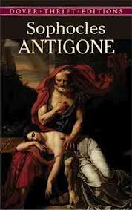
Advanced English 2 Unjust Laws and Cultural Traditions

