Slide 1
NAZI PROPAGANDA 1930s – 1940s

Slide 2
The Poisonous Mushroom was a collection of 17 short stories by the Nazi writer Ernst Hiemer, with pictures by the Nazi artist Fips. The purpose of the stories was to indoctrinate (brainwash) young German children to despise and hate the Jews. The stories infiltrated the thoughts and beliefs of German children. By studying them, historians can observe how the Nazis thought, and how they taught their children to think the same way as them.

Slide 3
Children’s Book Image

Slide 4
There is an old saying: ’the Jewish hawker Is a cheat and seducer. He lies all the time And you — you pay the price. So many have gone through the mill. Would you be saved from these penalties. Then don’t let the Jew come in And buy only from a German.”
Text at the end of the story:

Slide 5
Illustration from a children's book. The headlines say "Jews are our misfortune" and "How the Jew cheats." Germany, 1936.

Slide 6
German children read an anti-Jewish propaganda book titled DER GIFTPILZ

Slide 7
Page from the anti-Semitic German children's book - Trust No Fox in the Green Meadow and No Jew on his Oath

Slide 8
Image from a Children’s Book

Slide 9
Children’s Story

Slide 10
"What Hans and Else experienced with a stranger." The stranger is a Jewish man depicted as a child molester/kidnapper, and his intended victims, whom he is attempting to lure away with some candy, are innocent German children.

Slide 11
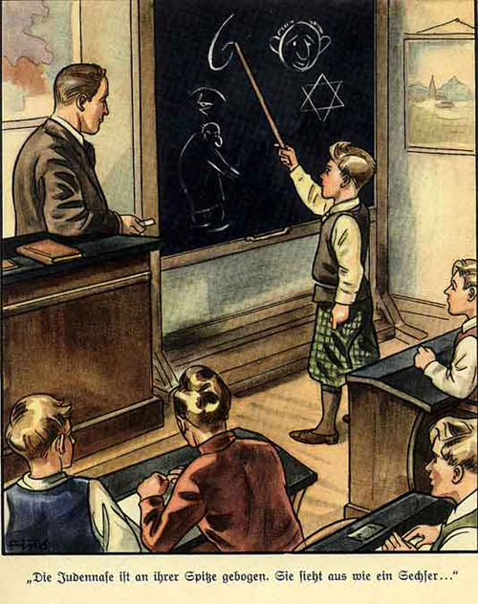

Slide 12
This illustration comes from the book Der Giftpilz, which was published in 1938 and was intended for children. In the scene, a class is taught how to recognize the physical characteristics of Jews. They are taught that the Jewish nose is hooked like the number six. Other attributes mentioned in the story are puffy lips, fleshy eyelids, and a “deceitful” look. Towards the end of the book, it is also claimed that Jewish people were responsible for the murder of Jesus, who is called their greatest enemy. Following the war, the publisher of the book, Julius Streicher, was judged to be responsible for dehumanizing the Jews in the lead-up to the Holocaust. He was found guilty at the Nuremberg trials and was executed in October 1946.

Slide 13
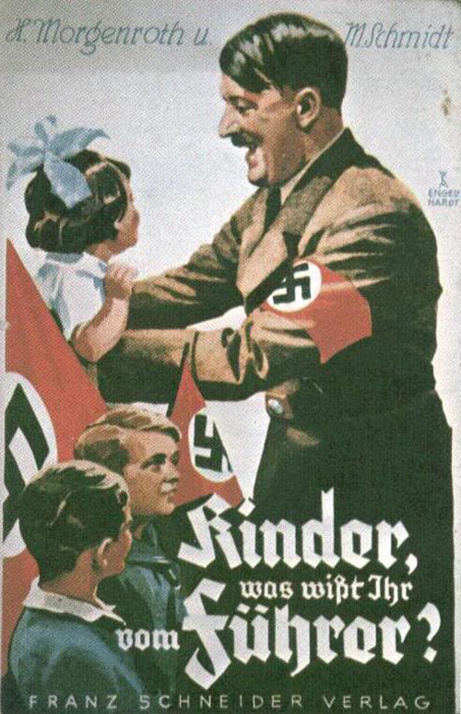

Slide 14
In the poster, the usually much more sternly portrayed dictator is depicted as an approachable figure – although still an authoritative one – who is friendly towards children. Hitler understood that his power depended on every German citizen regarding him as infallible and following his word above written law – the so-called “leader principle,” or Führerprinzip. This commonly led to Hitler being portrayed as a messianic, almost god-like figure.

Slide 15
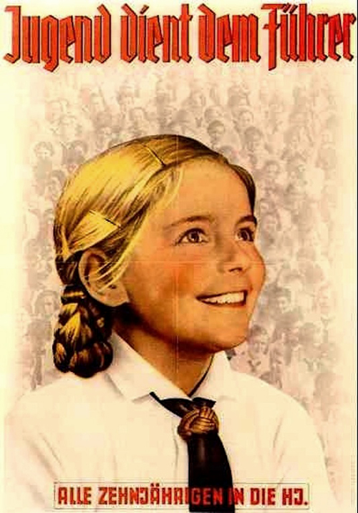
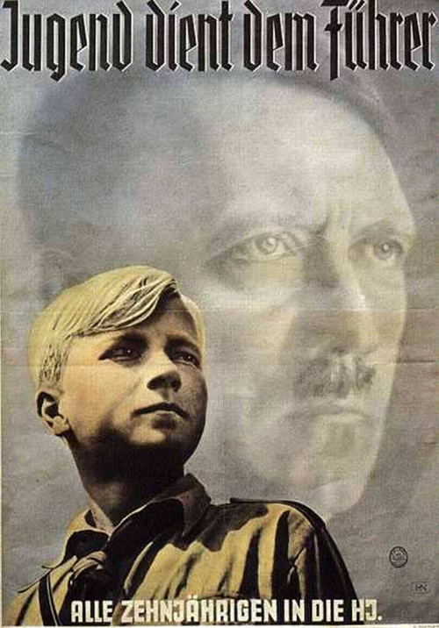

Slide 16
Membership in both the male and female leagues was compulsory for eligible children. Besides learning about motherhood and Nazi ideology, members of the girls’ leagues took part in activities like camping, skiing, and working the land. The third tier of female indoctrination, the Faith and Beauty Society for 17–21-year-olds, was voluntary. It aimed to prepare girls for marriage, domestic life, and future career goals. In line with the Nazi idea of rapidly increasing Germany’s population, the organization encouraged its female members to have as many children as possible. And as the war dragged on, the Leagues were increasingly called upon to help out, whether that meant collecting the harvest and serving as nursing aides, or fighting on the front lines.

