Slide 1
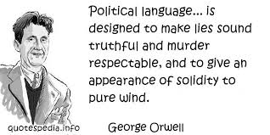
Quickwrite: Read George Orwell’s Quote. Write a well-developed paragraph analyzing its meaning and relate it to: Night, the holocaust, your assigned genocide, animal farm, lord of the flies, or any other historical/current event(s).

