Slide 1
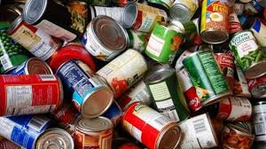
Food Drive
By Bethany Hammer, Curtis Regan, Davis Masters, Lucas Ault, Mary Holbert, Kameron White and Jay Cardoza

Slide 2
Explain how our group could make it a possibility for students on free and reduced lunch to obtain access to food over Spring Break
Our definition: Created a competition to collect food for students in need
Collect enough food for multiple students to have meals for over break
Everything had to be confidential

Slide 3
Approach
Create a plan to ¨raise¨ food(competition)
Explain to classes our plan
Find boxes for each class
Check/collect weekly
Spoke to teachers/counselors/APs about creating a list
Created survey as to who needs food(dback)
Made slips for students to pick up food(confidential)
Made boxes & separated food
Students received slips & grabbed food

Slide 4
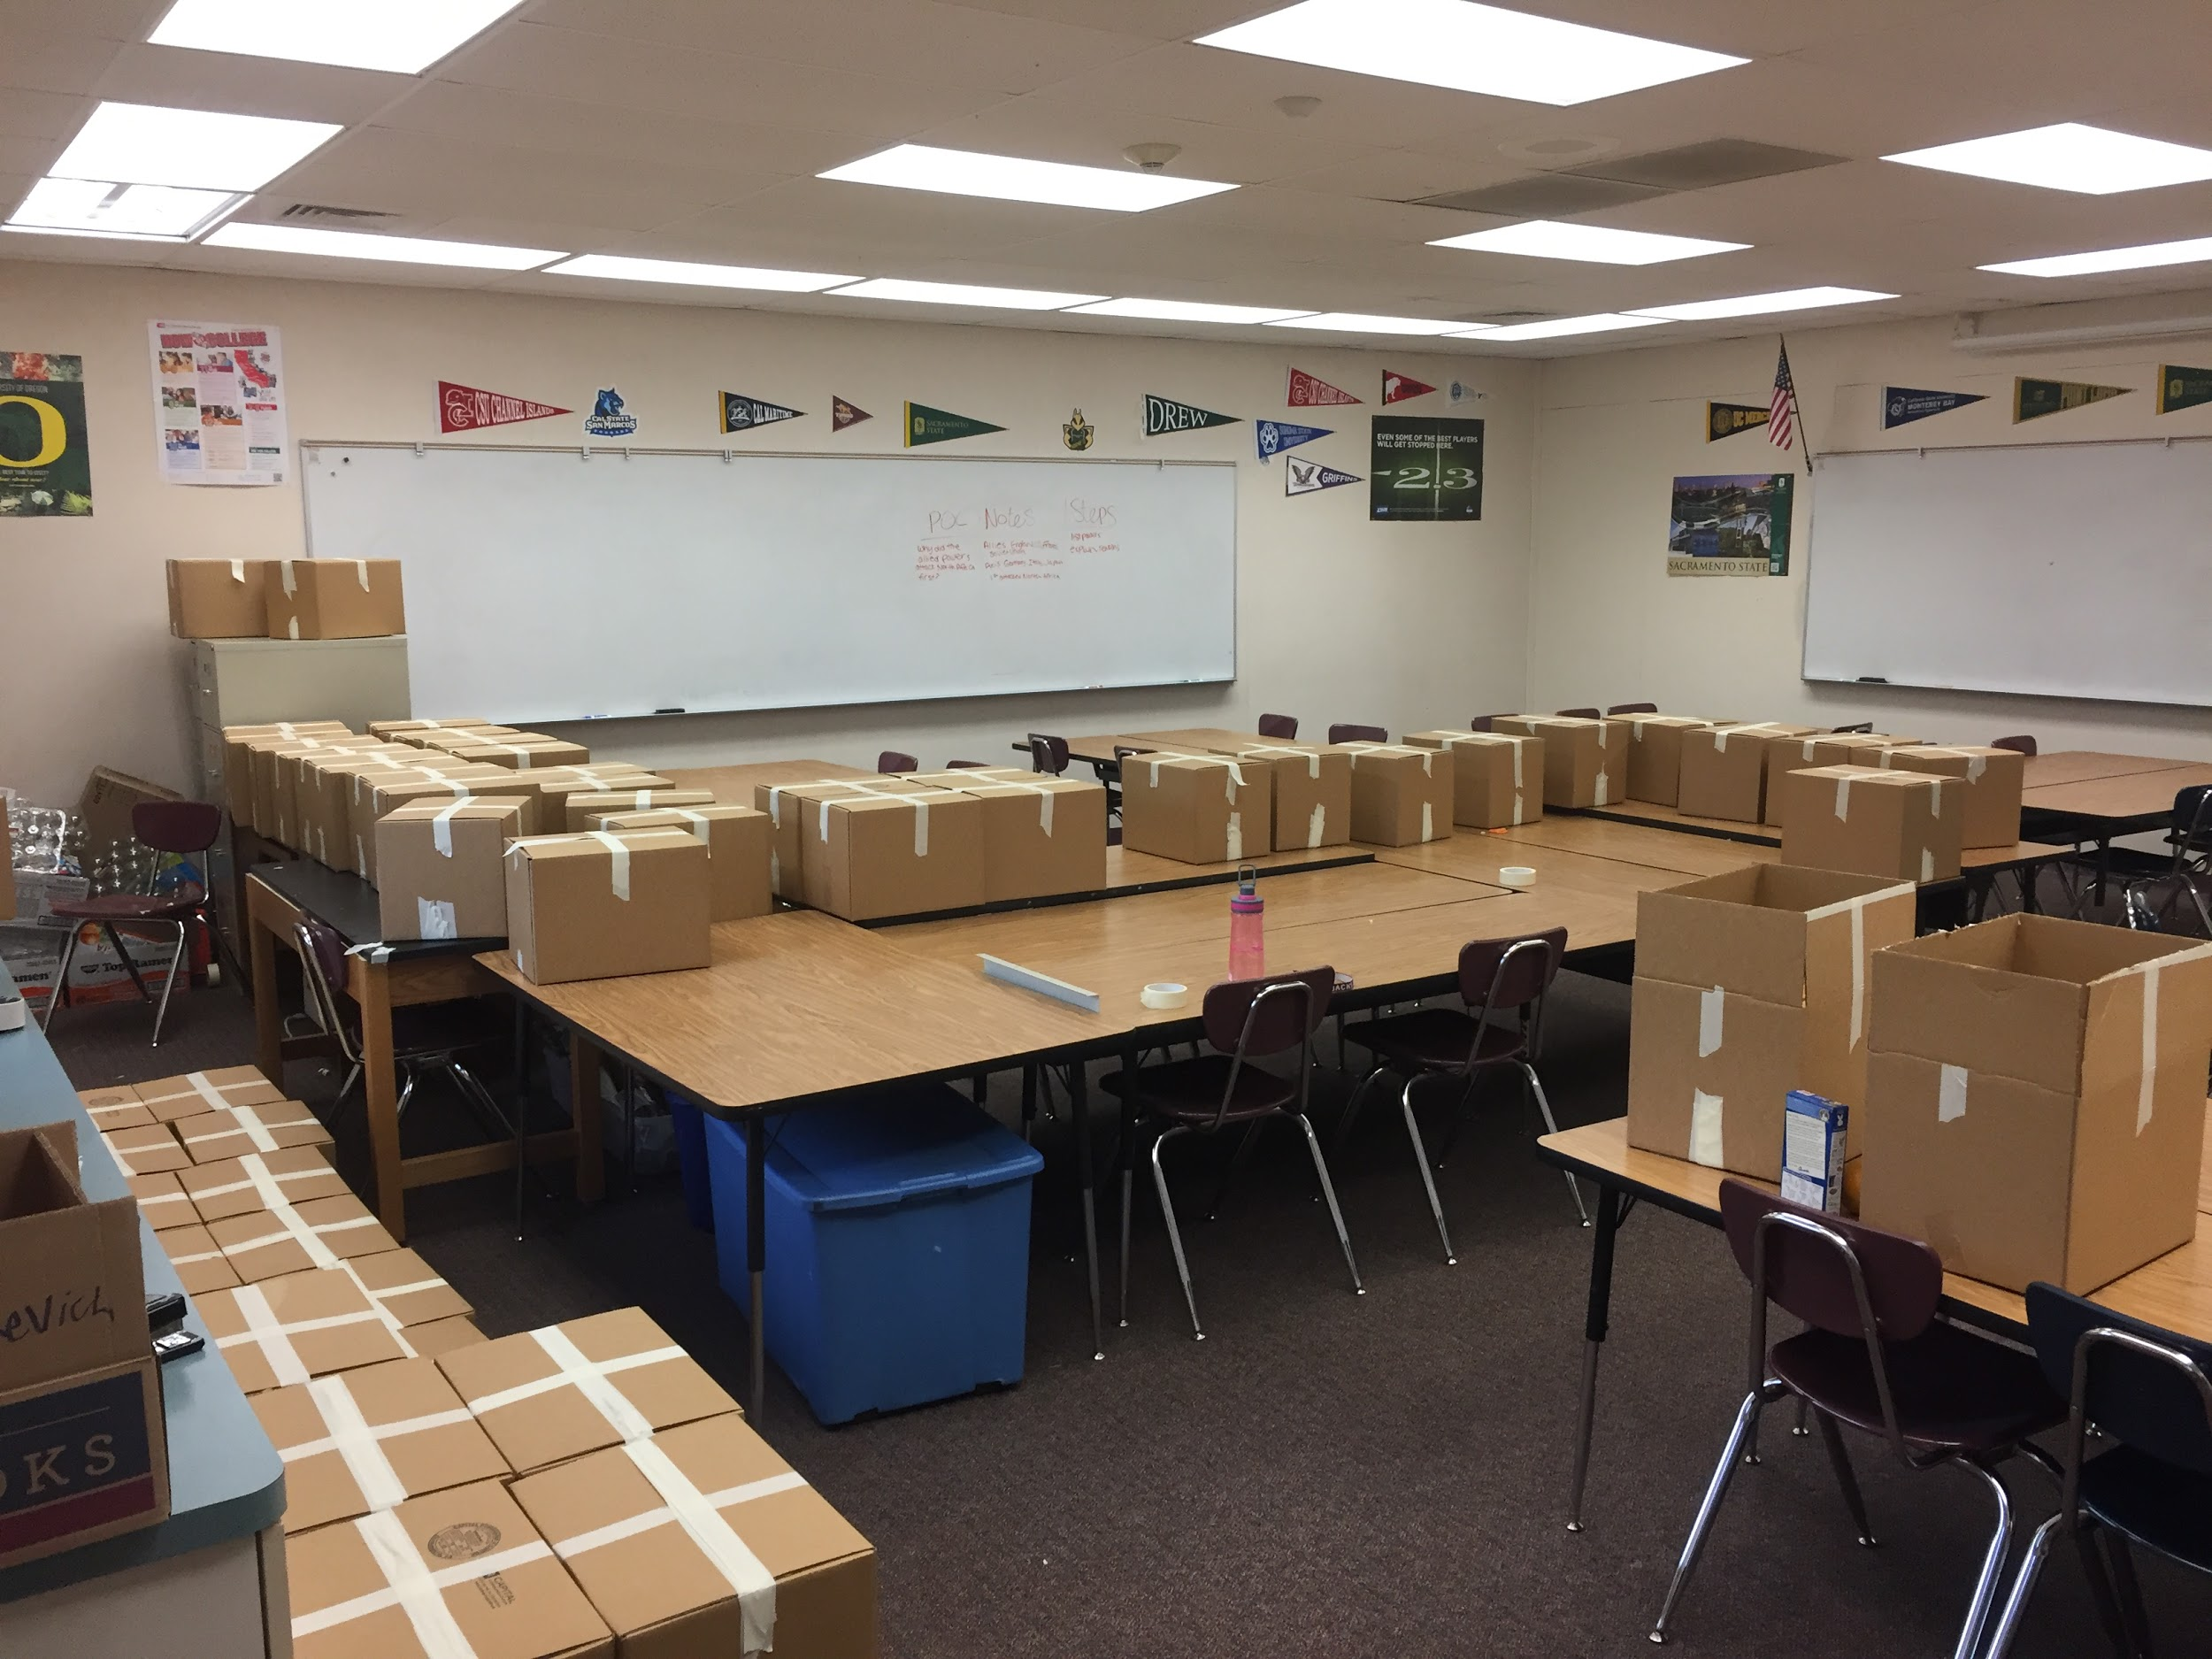
Outcome
Total food collected: 1576 cans and dry food
Good variety(fruit/canned/dry)
Students: 54
Total that came: 29

Slide 5
Pros & Cons
Great!
How much food total
Participation
Variety
Students ended up with food
Raised awareness
Not so great..
Not all students got their food
Shyness
A joke to some
Not all classes participated
Students could´ve received more food if we would have known not all students wanted their boxes

Slide 6
Things We Would Change
Find a way to clarify who wants their box for sure. The food from the unwanted boxes could be distributed into the boxes actually going to students so that they would have more food and we would not waste any.
Some kids lied just to get ¨free food¨
We wish we could have found a way to keep all of the classes engaged in the competition(bored)

Slide 7
Overall
The food drive went pretty well since it was the first time that students have ran one. We collected a lot more food than expected, made it fun for all of the classes, and successfully helped students in need. Maybe in the upcoming years, the students will be willing to continue the food drive for students who might need it over breaks and hopefully students will be even more willing to donate for the kids around them.

